Slide 1
SATURDAY DECEMBER 31ST 2022
A1.303 – 8H00

Slide 2
Object-Oriented Programming Monopoly Universe
Presented by FLOP TEAM

Slide 3
TEAM MEMBER
Nguyen Tran Trung Quan | Leader
Nguyen Hoang Anh Tu | Member
Nguyen Quang Dieu | Member
Nguyen Hai Ngoc | Member
Hoang Tuan Kiet | Member

Slide 4
Table of contents
01
INTRODUCTION
02
METHODOLOGY
03
INSTALLATION
04
DEMO
05
ACKNOWLEDGEMENTS
06
CONCLUSION

Slide 5
01
INTRODUCTION

Slide 6
PURPOSE
Create a game that is redesigned to entertain and educate players.
Practicing OOP techniques in the Theory class.
Go through the process of game management and code refining.
Evaluate the ability to build more features on top of the basic code.

Slide 7




USAGE tools
IntelliJ
UML
To
code the game
Drawing UML diagram by Visual Paradim Online
Github
Notion
Managing project
Managing tasks

Slide 8
02
METHODOLOGY

Slide 9


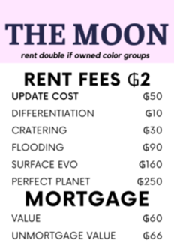


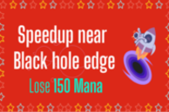

The DESIGN
2
3
1

Slide 10
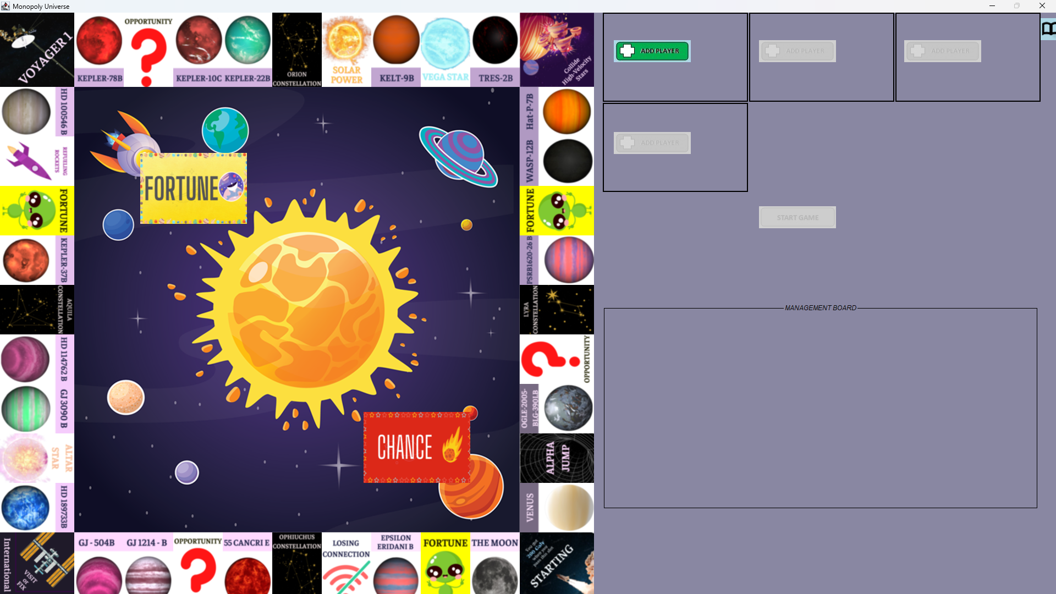
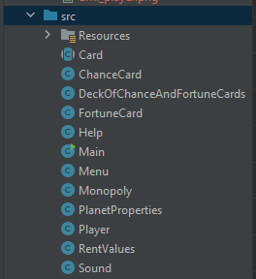
The DESIGN
UI/UX
ALGORIT.

Slide 11
The RULES
Objective
Initial money
Gameplay
Starting point
Buying properties
Chance & Fortune

Slide 12
The RULES
ALPHA JUMP/ LOST CONNECTION
COLLIDING
COLLIDING RULES
RESTORING SPACECRAFT
REFUELING
PLANET UPGRADE

Slide 13
The RULES
DOWNGRADE COST
MORTGAGE PLANET
DECLARE BANKRUPT

Slide 14
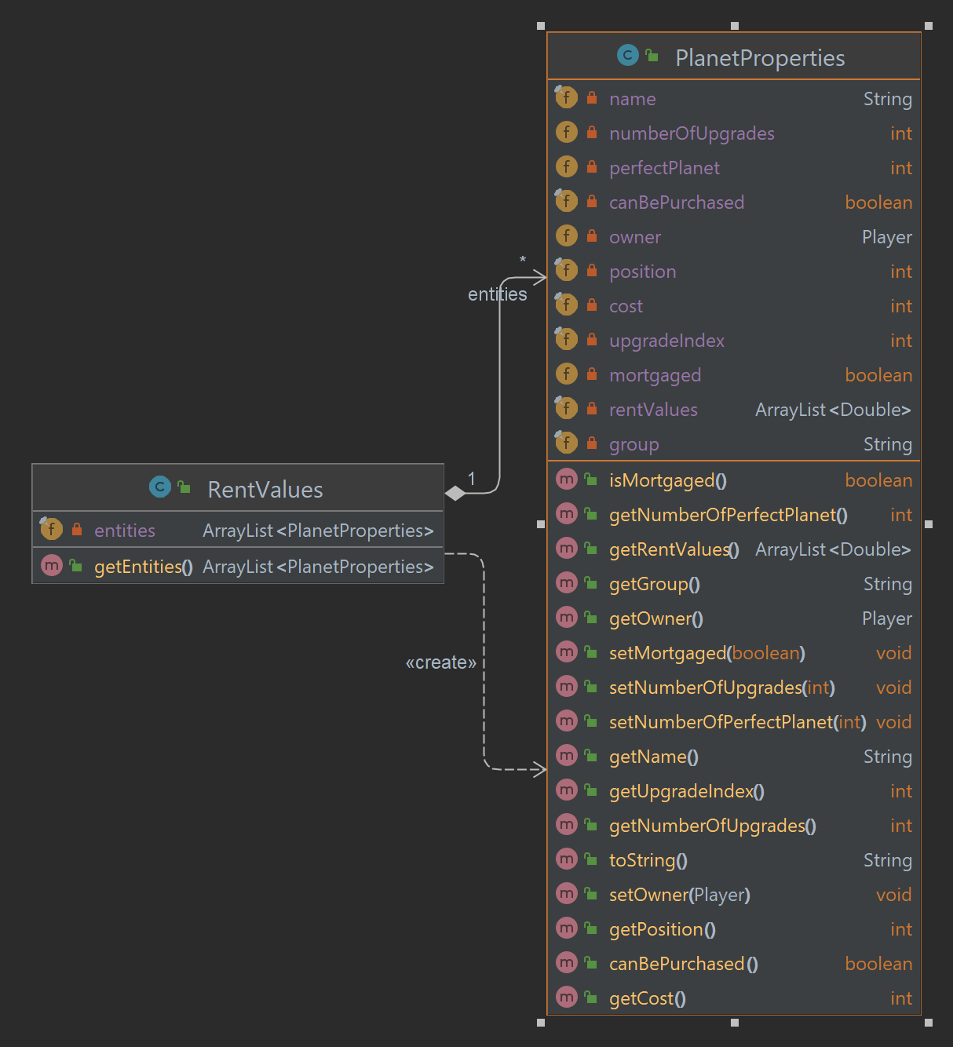
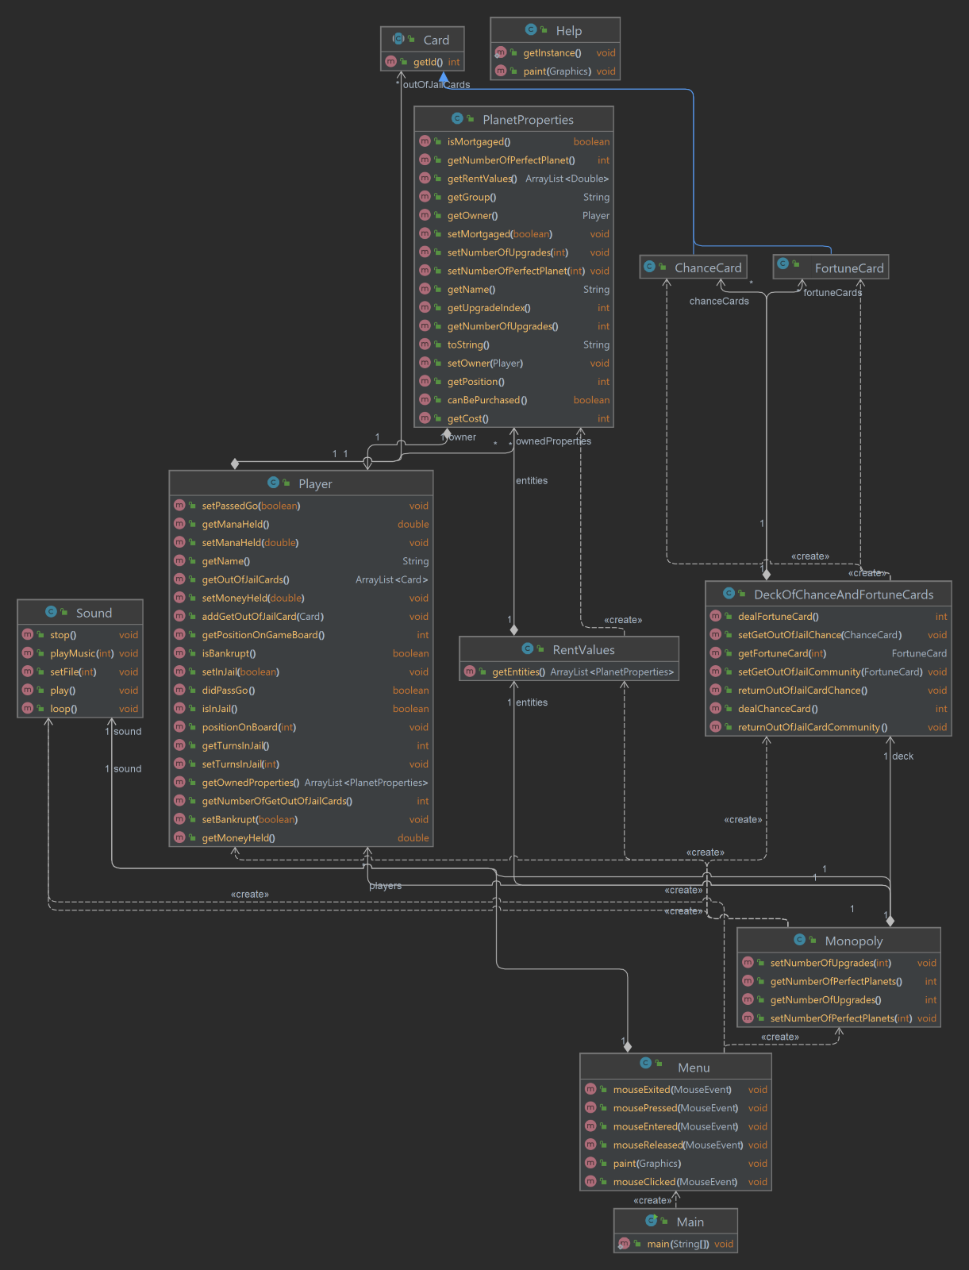
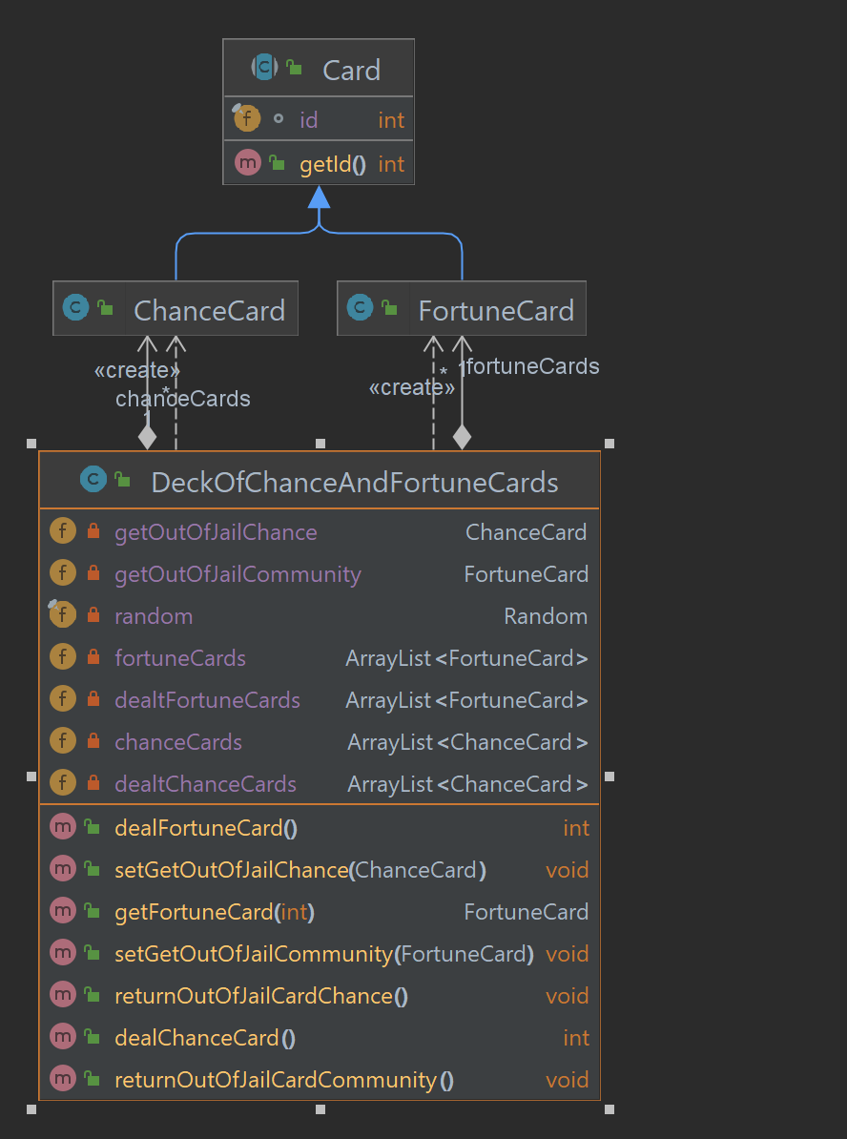
UML diagram (FULL AT GITHUB)

Slide 15
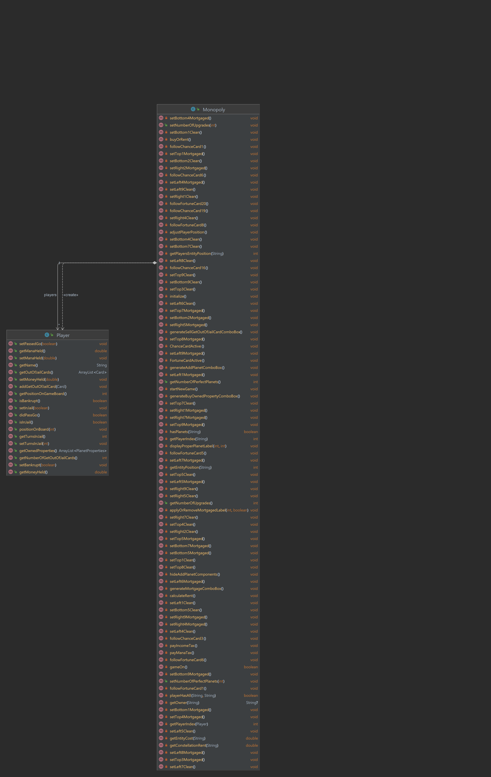
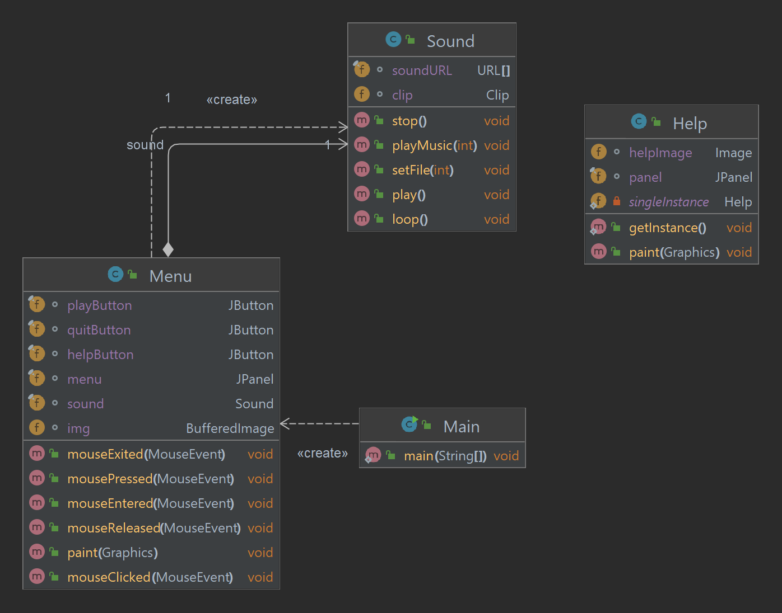
UML diagram (FULL AT GITHUB)

Slide 16
CARD
ArrayList to store the information of each card
A method of dealtCard() uses a Random class
Combine with the getCard() method to give the main game which card it needs to work with.

Slide 17
PLANET
PlanetProperties has many attributes
Inside RentValue is the ArrayList of entities where we initialize all. Planets.

Slide 18
PLAYER
The same goes with Planet; inside Player, we also create a list of attributes specified to that Player
The Monopoly class is an all-in-one place for the game to create with the help of JFrame libraries and Java Swing components
It also holds the control logic of the game for features like the upgrade, creation player, and management board.

Slide 19
MAIN
Iinitializes a screen that gets an instance of the Menu class
Inside the Menu class is where the mouse clicks on each section: Play, Help (singleton design pattern), and Quit
Sound class is added to provide the game with sound.

Slide 20
03
INSTALLATION

Slide 21
04
DEMO

Slide 22
05
ACKNOWLEDGEMENTS

Slide 23
SINCEREST thanks to
Dr. Tran Thanh Tung
MSc. Pham Quoc Son Lam
Original code from pawelpaszki
The sites Geeksforgeeks, Javapoints, and so on
The README.md template from othneildrew

Slide 24
06
CONCLUSION

Slide 25
Future ROADMAP
Trading feature
Mana bars
PvP

Slide 26
REFERENCES
All Resources | Resources. (n.d.). NASA Solar System Exploration. Retrieved December 31, 2022, from https://solarsystem.nasa.gov/resources/all?order=pub_date+desc&per_page=50&page=0&search=&condition_1=1%3Ais_in_resource_list&fs=&fc=&ft=&dp=&category=
Drew, O. (2022). Othneildrew/Best-README-Template. https://github.com/othneildrew/Best-README-Template (Original work published 2018)
Exoplanet Catalog | Discovery. (n.d.). Exoplanet Exploration: Planets Beyond Our Solar System. Retrieved December 31, 2022, from https://exoplanets.nasa.gov/discovery/exoplanet-catalog
How to play Monopoly | Official Rules | UltraBoardGames. (n.d.). Retrieved December 31, 2022, from https://www.ultraboardgames.com/monopoly/game-rules.php

Slide 27
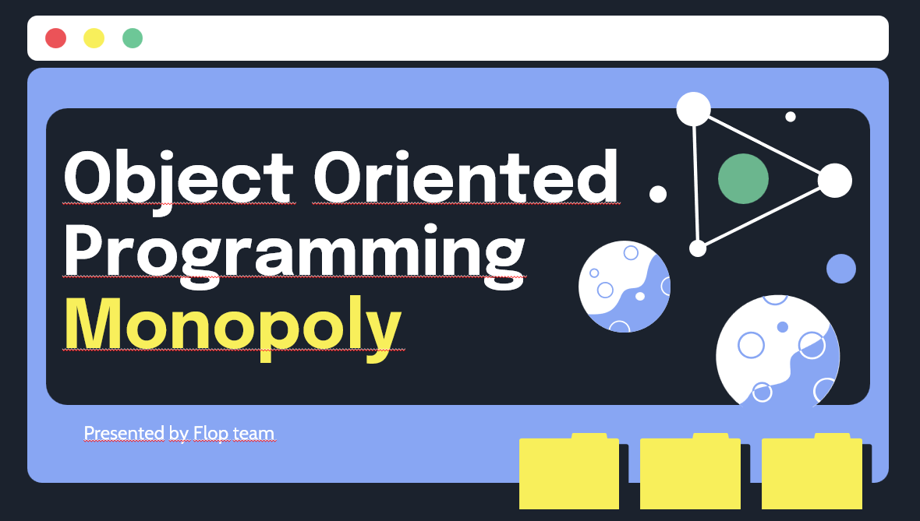
thank you
have q&a?

